Slide 1


Write, Build, and Deploy
Supersonic and
Subatomic Java
Applications
Martin Trajkov
Software Engineer, IT Labs
https://www.linkedin.com/in/martin-trajkov/

Slide 2


AGENDA
What is Quarkus?
Quarkus Features
JIT vs AOT
GraalVM
Quarkus vs World
Demo

Slide 3

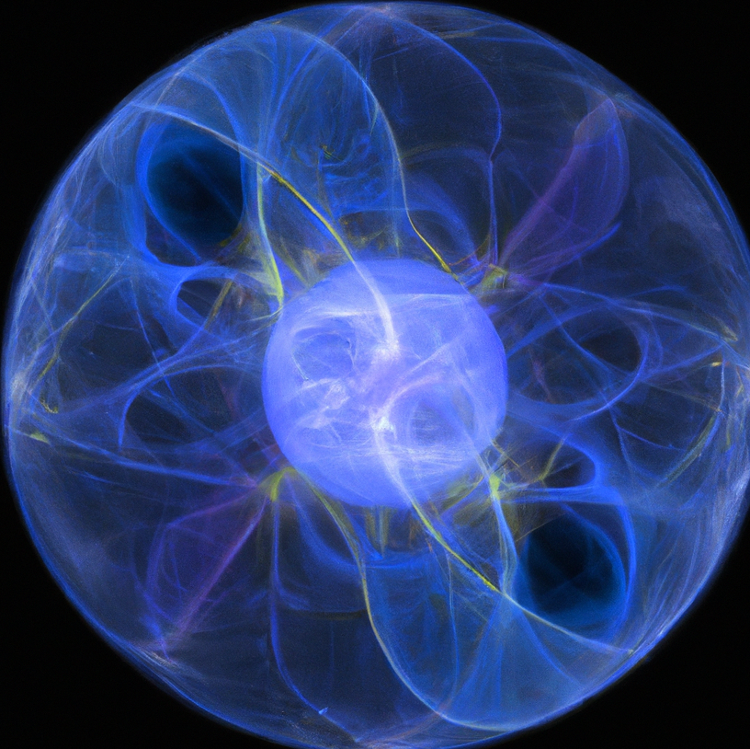

What is Quarkus?
“Supersonic”
“Subatomic”
“Java”

Slide 4









What is Quarkus?
Created in late 2018;
Open-source;
Red Hat;
Microservices;
Functions (FaaS) or Serverless;
Reactive Systems;
Any kind of application.

Slide 5

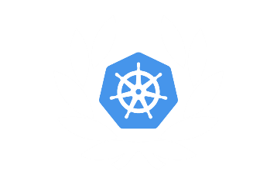



What is Quarkus?
Container First
Unifies imperative and reactive
Kube-Native
Developer Joy
Community and Standards

Slide 6
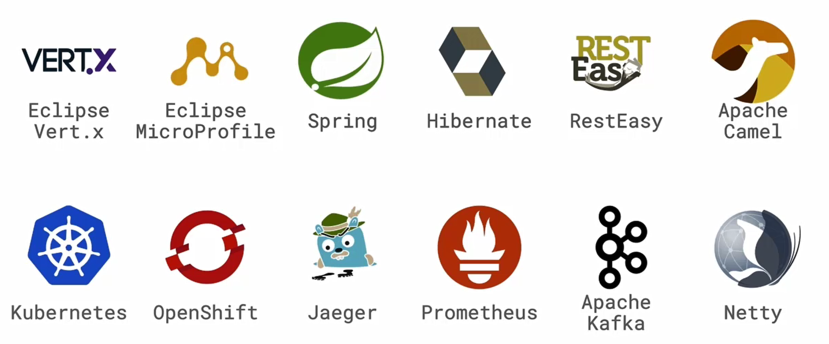

Extension Mechanism

Slide 7
Just in Time Compilation (JIT) vs Ahead of Time Compilation (AOT)
Startup Speed
Peak Throughput
AOT
JIT
Low Memory
Footprint
Reduced
Max Latency
Small Packaging

Slide 8





GraalVM
High Performance
AOT Native Image Compilation
Polyglot Programming
Advanced Tools

Slide 9
Quarkus pushes Java to the Cloud
Traditional Java framework
4.3s
Quarkus + HotSpot (JIT)
0.75s
Quarkus + GraalVM (AOT)
0.014s

Slide 10
Quarkus pushes Java to the Cloud
Traditional Java framework
9.5s
Quarkus + HotSpot (JIT)
2.5s
Quarkus + GraalVM (AOT)
0.055s

Slide 11
Quarkus pushes Java to the Cloud
140 MB
77 MB
19 MB
Traditional
Java framework
Quarkus + HotSpot
(JIT)
Quarkus + GraalVM
(AOT)

Slide 12
Quarkus pushes Java to the Cloud
118 MB
130MB
35 MB
Traditional
Java framework
Quarkus + HotSpot
(JIT)
Quarkus + GraalVM
(AOT)

Slide 13
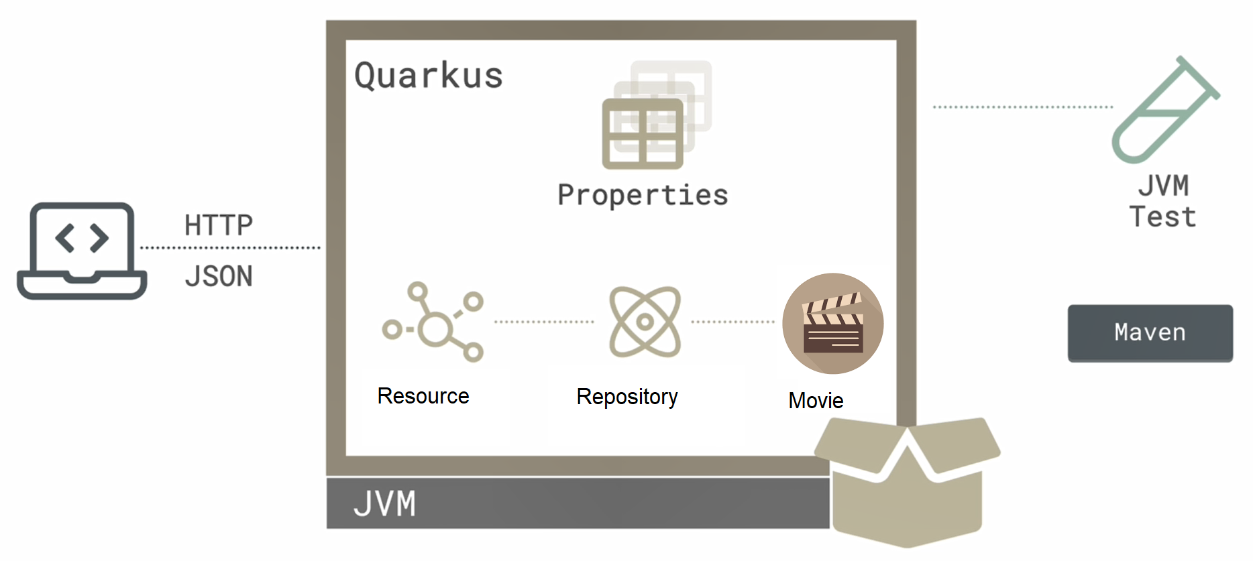
Demo

Slide 14
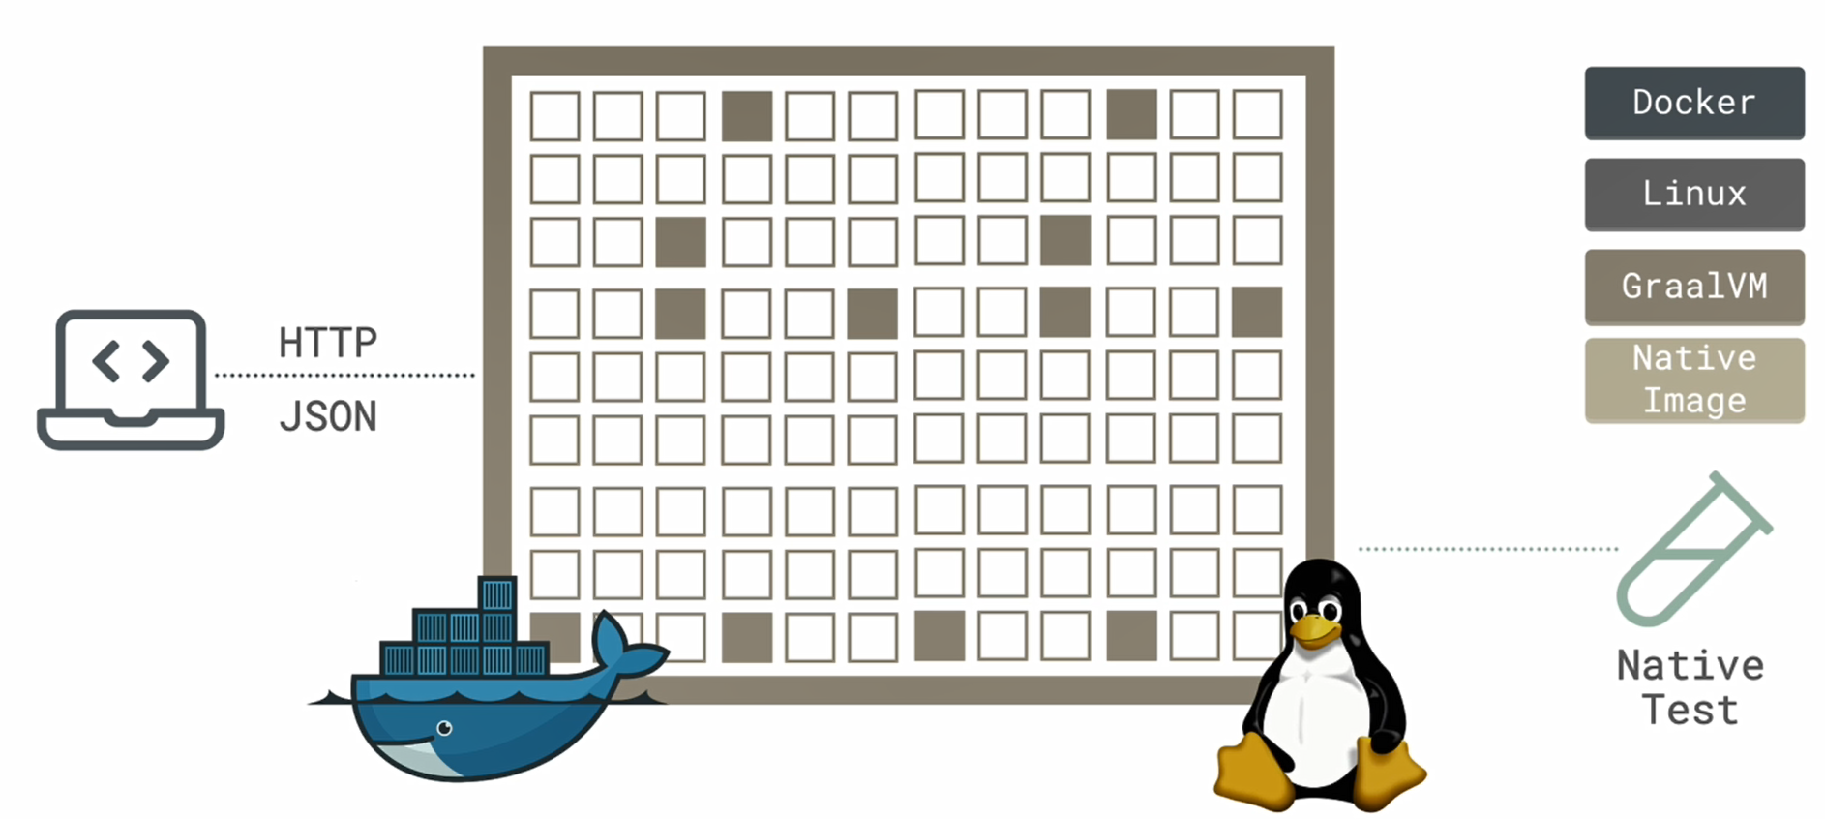
Demo

Slide 15

Code
https://github.com/IT-Labs/Quarkus

Slide 16

Key Takeaways
Slow Build
Fast Startup
Memory Footprint
Good Testing
Community
Serverless and Microservices

Slide 17

QA ???

Slide 18




Thank You!
contact@it-labs.com
+1 800 920 4829
www.it-labs.com

